Slide 1
UTILIZZO, LIMITI E AVVERSITA’ DEI TRATTAMENTI DI DRENAGGIO INTERNO
Francesco Paolo zito
U.O.C. gastroenterologia ed endoscopia digestiva
A.O.r.n. Antonio cardarelli
Napoli

Slide 2
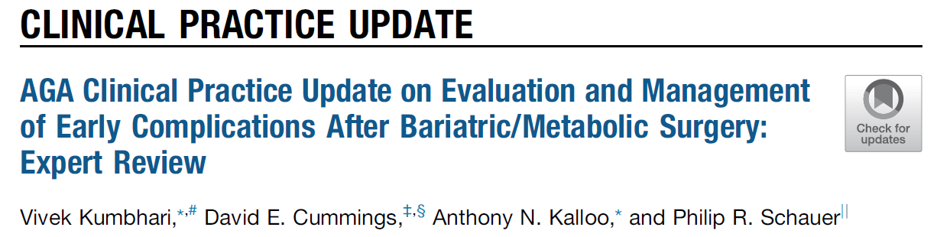
Treatment algorythm are not standardized (poor quality of studies)
Close the leak might not be the ideal treatment strategy for chronic leaks/fistulas (> 6 weeks?)
Rationale for internal drainage
Intragastric pressure is lower than that of the perigastric collection
Contents will preferentially flow out of the collection, into the stomach
Clinical Gastroenterology and Heptology 2021

Slide 3
Beware clinical presentation
Obese patient = complex management
Stable patient
Infection withouth sepsis
Localized peritonitis
No mediastinitis
NO NEED
Surgical/percutaneous
drainage
Complete drainage of the colletion
EID
Unstable patient
General sepsis
Diffused peritonitis
Mediastinitis
NEED
Surgical/percutaneous
drainage
Promote heealing allowing early drainage retrieval
EID
Obesity surgery 2019

Slide 4
Not all leaks are made equally
Intragastric pressure < intra abdominal pressure
intragastric drainage
Downstream stenosis
Percutaneous drainage
Intra Abdominal pressure
↑ ↑ intragastric pressure
↓ ↓ intra-abdominal pressure
Intraluminal Gastric
pressure
Air pressure
External drainage
(Percutaneosu or naso-collection)
Variation of
stomach-collection gradient

Slide 5
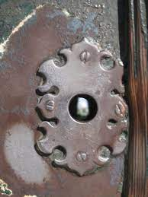

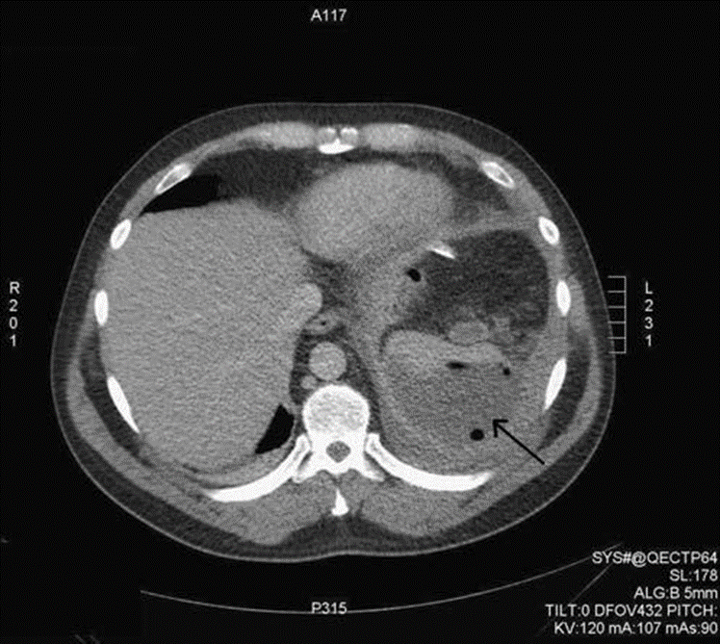
Never underestimate
Perigastric collection require pre-operative radiologic CT scan evaluation

Slide 6
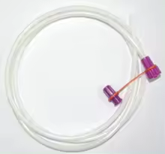
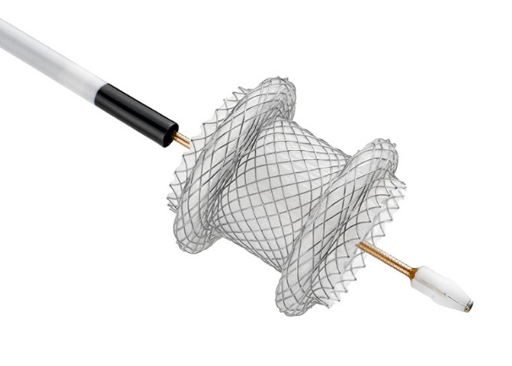
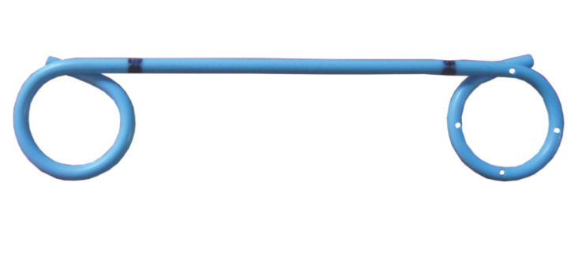
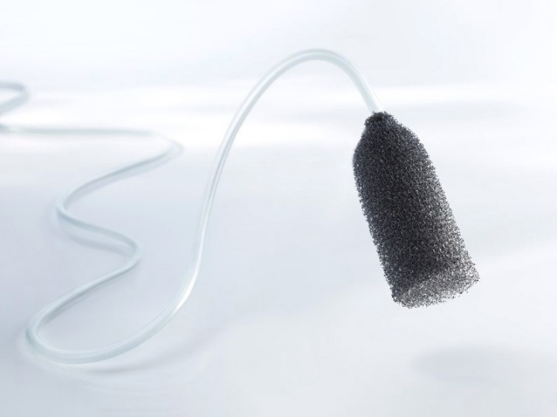
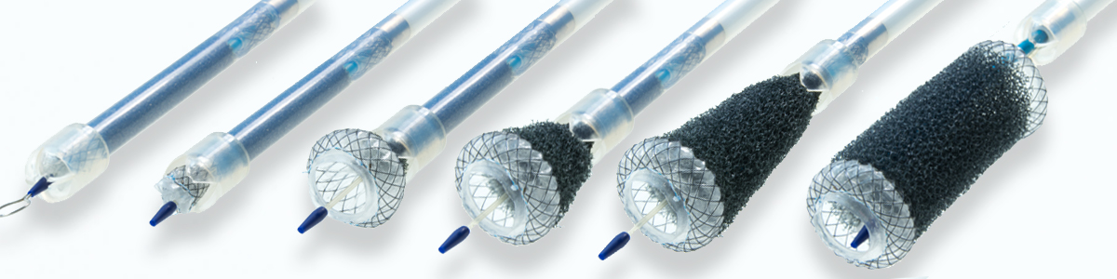
Endoscopic internal drainage - devices
Double pigtail plastic stent
Naso-jejunal tube
LAMS
Vacuum therapy endoscopic devices
VAC-stent®
ESOsponge®

Slide 7
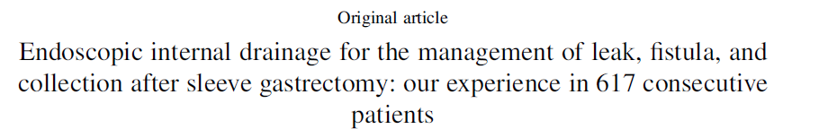
Clinical success 84.7%
28 Aes (4.5%)
617 patients
300 leaks
285 fistulas
32 collections
10/547 (1.8%) recurrence at FU
Failure/need for surgery
15.3%
Factor influencing therapeutical success
Previous emergency surgery (OR 1.7)
Presence of fistula (OR 2.1)
Combined approach (OR 2.31)
Previous endoscopic treatment (OR 4.8)
Donatelli G. et al., Obesity Surgery 2021

Slide 8
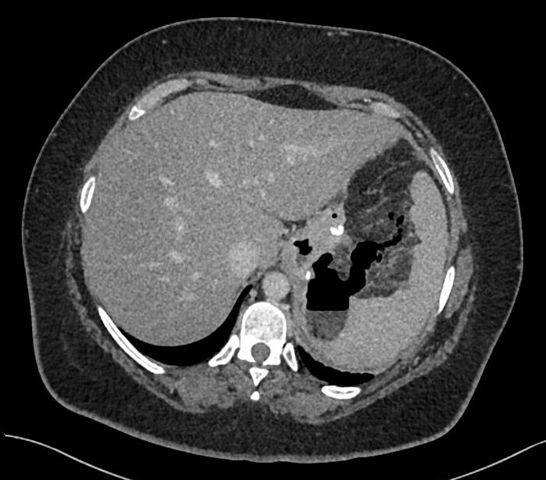
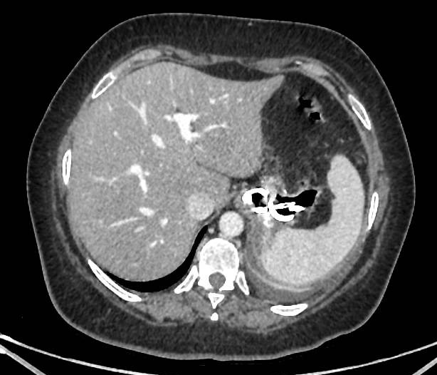
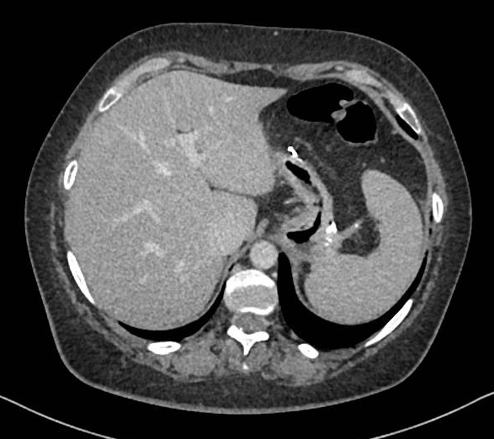
Leak post-LSG treated with EID
Pre-procedural
I EID
Final result
N° of treatment required 3
N° of pigtail used (total) 8

Slide 9
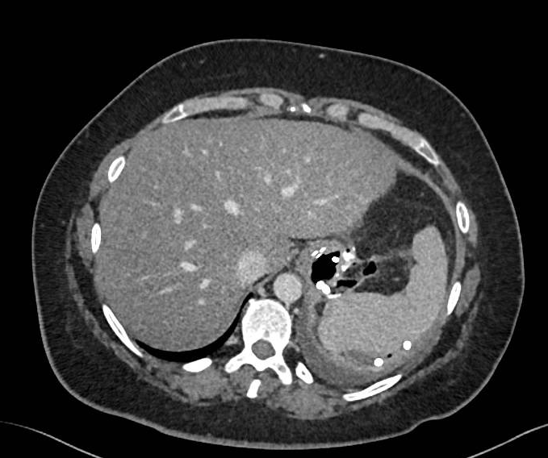
Retrosplenic collection
Pig-tail deployed

Slide 10
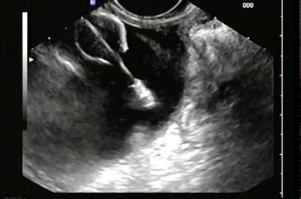
EUS-guided drainage
If the wall defect is not detectable
Courtesy by Donatelli G.

Slide 11
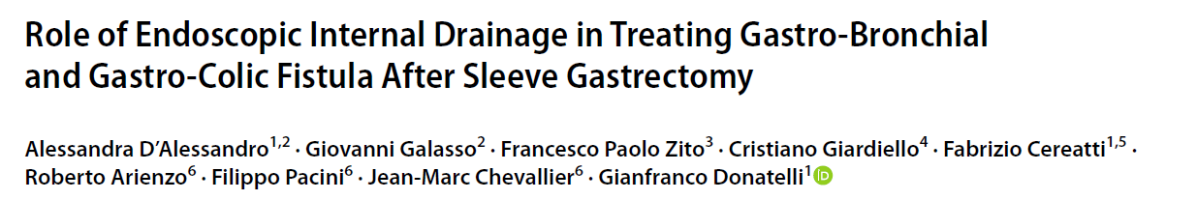
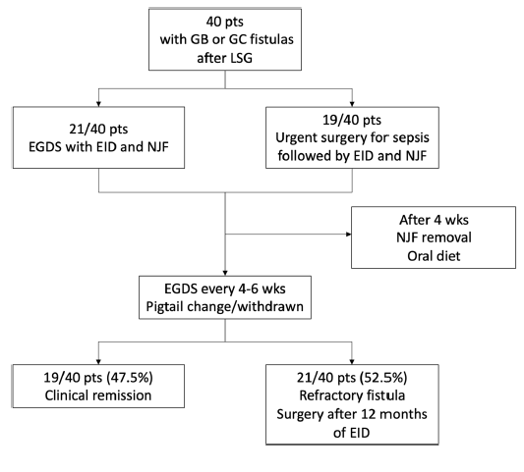
Obesity Surgery 2022

Slide 12
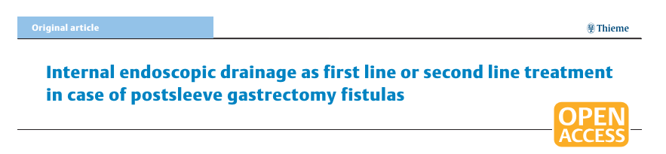
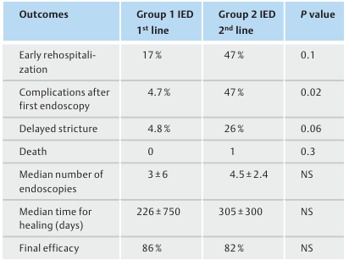
Retrospective study
44 patients with leak post-LSG
Group 1: n°22 IED as first line
Group 2: n°22 IED as second line
Gonzalez JM et al., Endoscopy international open 2018

Slide 13
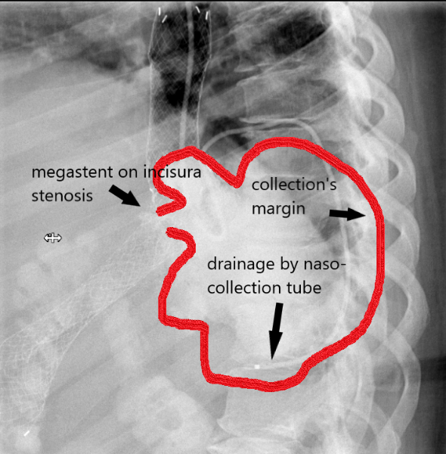
Combined endoscopic therapy
Naso-collection tube
In case of large collection, not drained percutaneously
Granata et al., Surgical Endoscopy 2019
Shehab et al., Obesity Surgery 2016

Slide 14
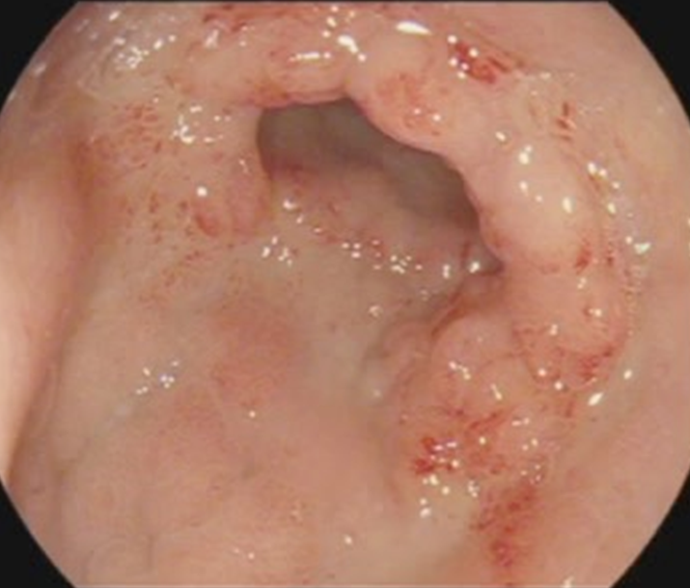
Endoscopy at the end of treatment
GRANULATION TISSUE
ABSENCE OF PURULENT SECRETION
SECOND INTENTION HEALING

Slide 15
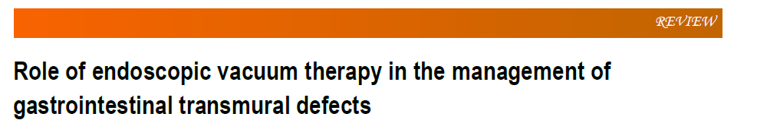
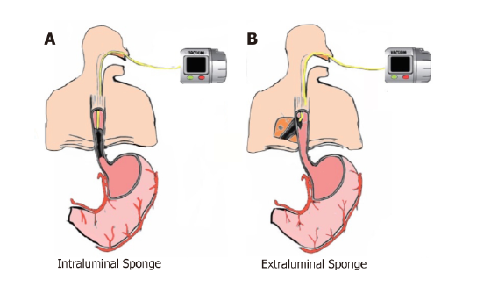
Mechanism of action
Reshaping the edge of the defect
Improvement in tissutal perfusion
Improvement of exudate cleansing
Icreased bacterial clearance
De Moura DHT et al., WJGE 2019

Slide 16
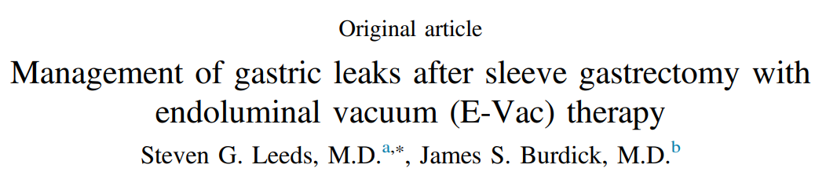
9 patients with post-LSG leak
BMI range 35 – 61
Age range 29 – 70
Success rate 8/9 patients (89%)
Failure because of two leaks form the same cavity
Limitations
Discomfort caused by NGT
Tricky application of the device
Surgery for obesity and related diseases 2016

Slide 17
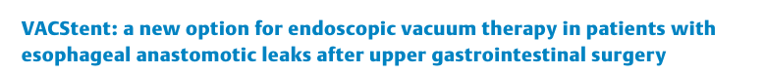
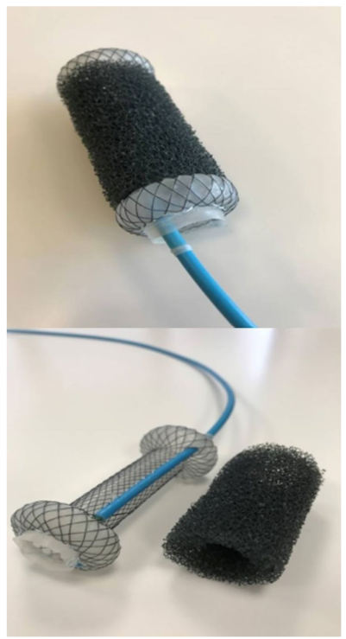
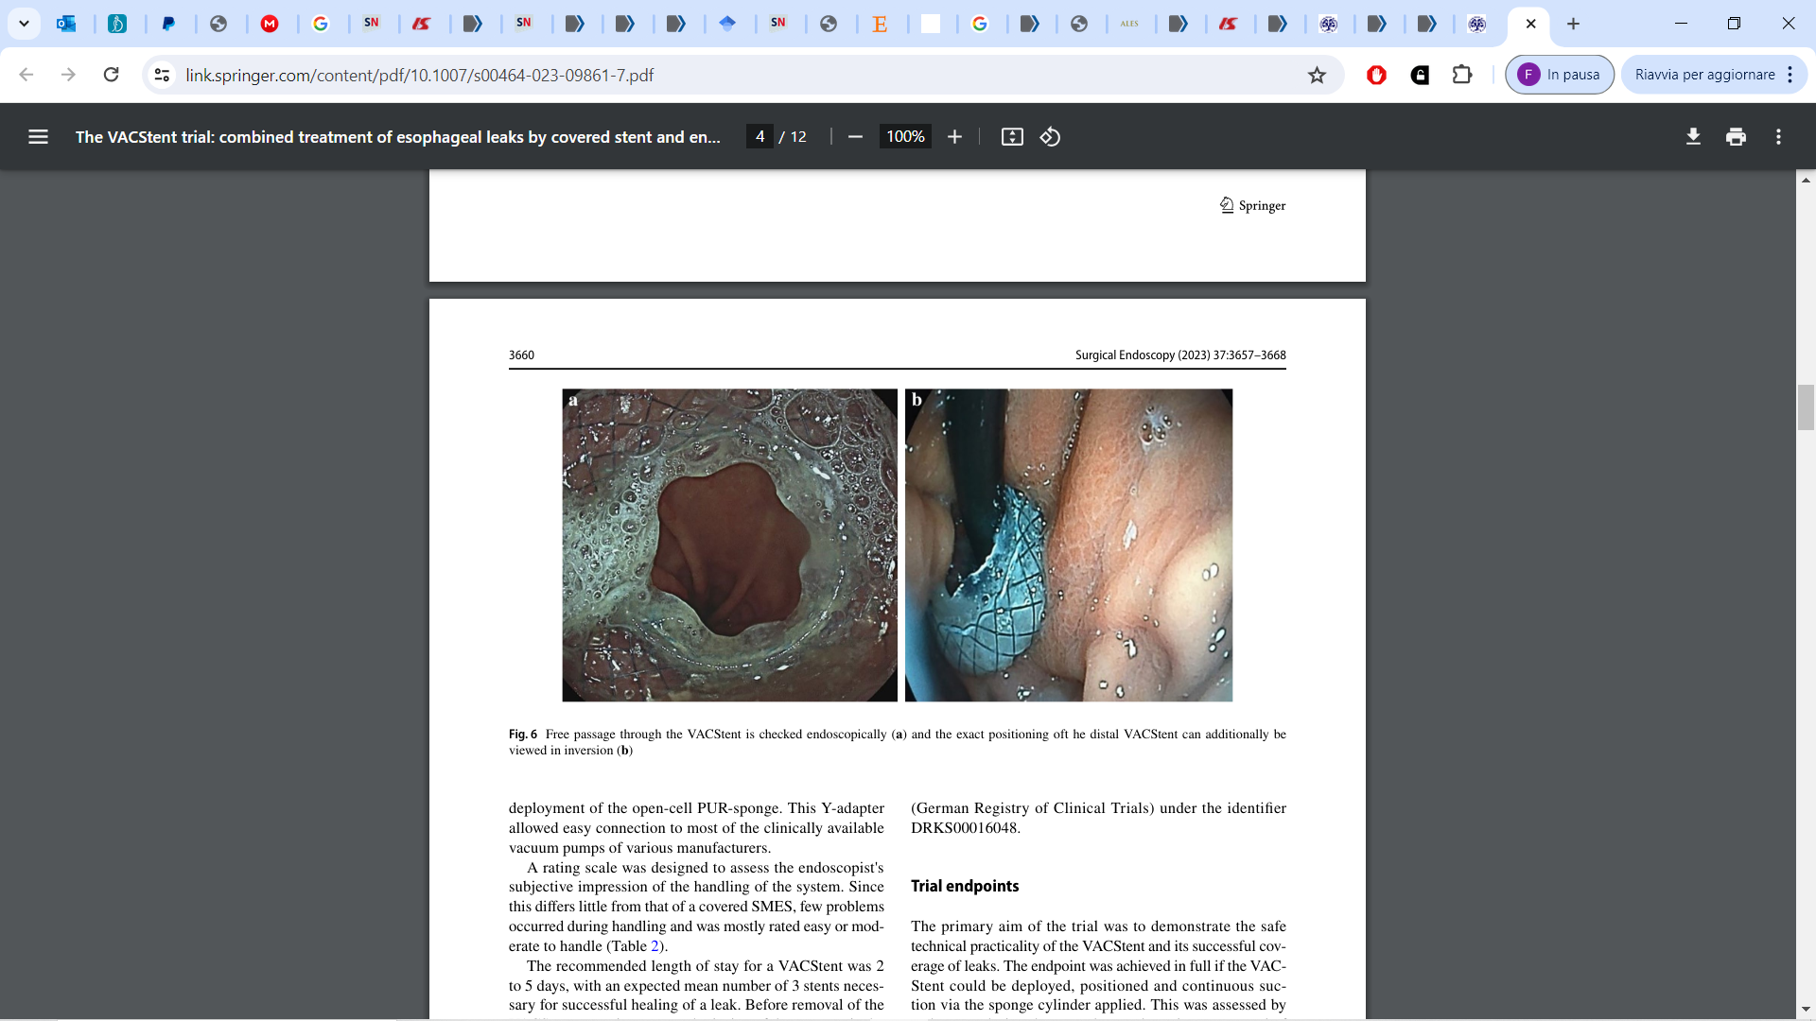
VAC-stent: combination of SEMS + Sponge
Advantages
lumen open after release (oral fluid or food intake).
sponge position secured
negative pressure optimized
PU foam isolated from saliva and other intestinal secretions
Chong Seung-Hung et al., Endoscopy 2020

Slide 18
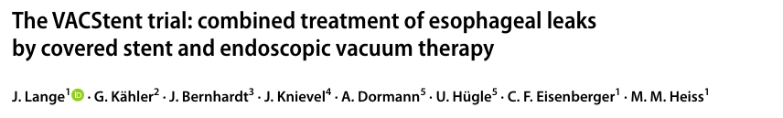
15 patients with post-surgical UGI leak
Stent placement
Technical success 41/41 (100%)
Mean number of stent per patient 2.7 (2 – 4)
Mean length of total treatment (gg) 15 (4 – 55)
Clinical success 13/15 (87%)
Complete healing 12/15 (80%)
Serious adverse event 0
Mortality rate 0
2-5 days
Not more than 7!!
Pressure applied
-80 ∆ -125 mmHg
Stent removal
Surgical Endoscopy 2023

Slide 19
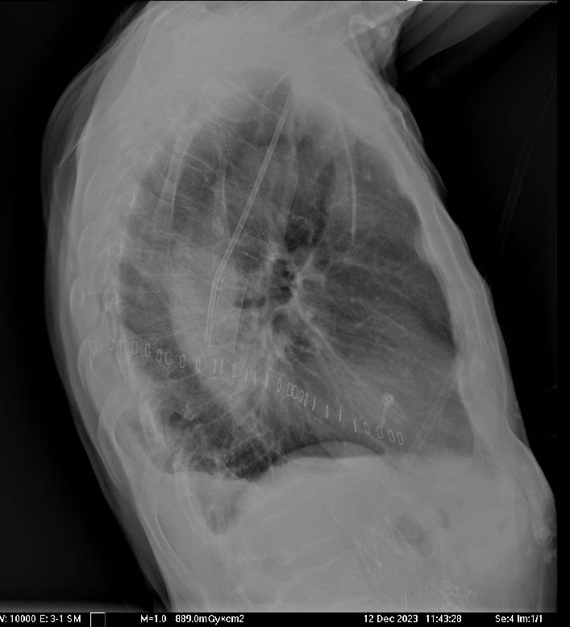
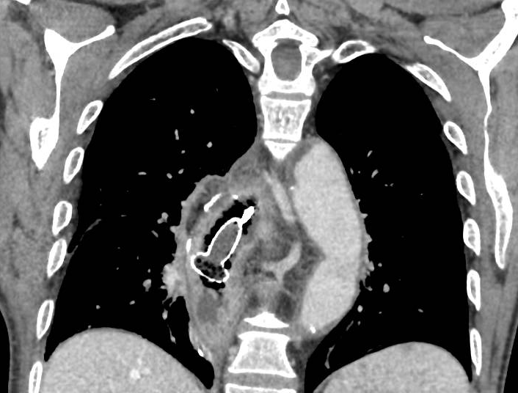
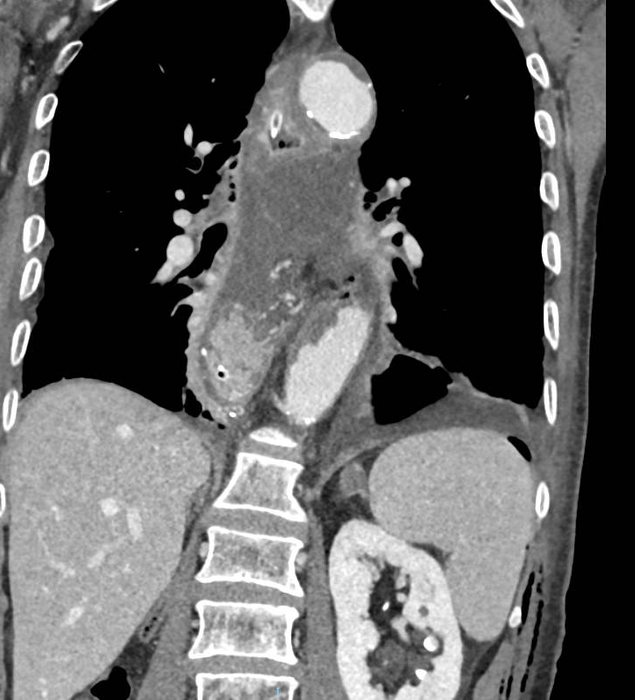
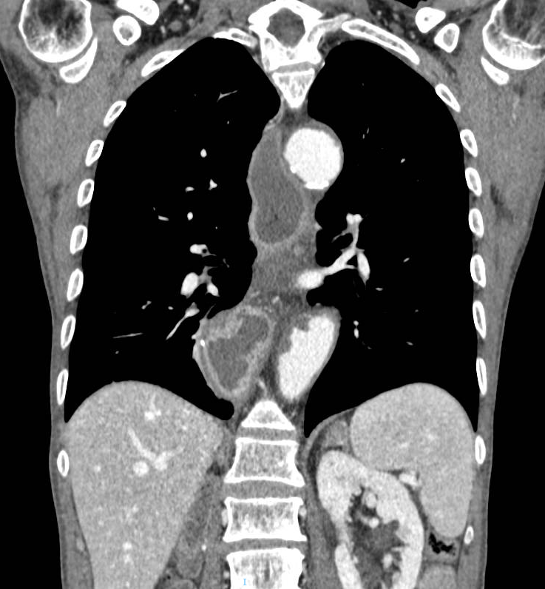
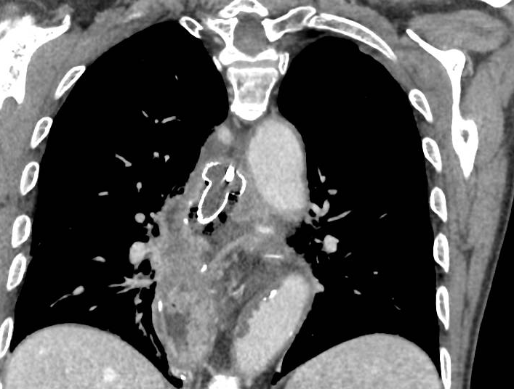

Slide 20
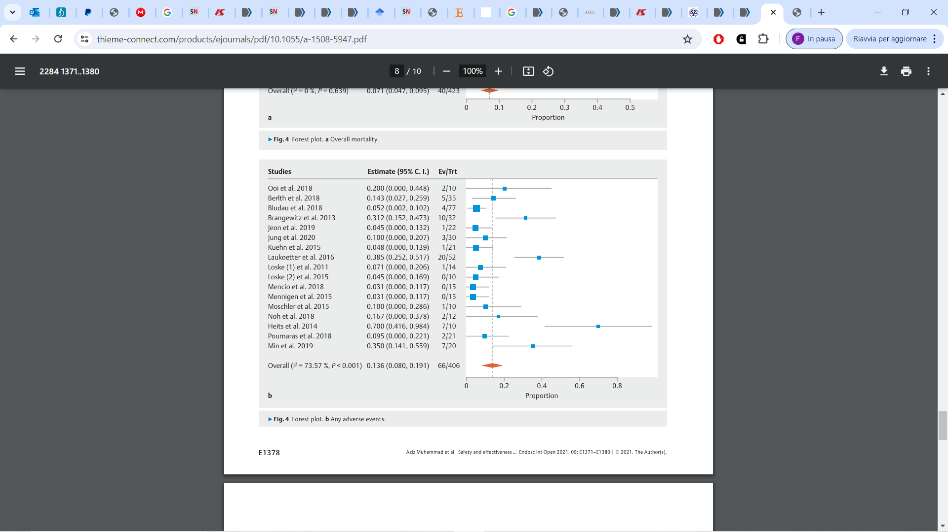
Adverse events
Few adverse events described in literature
Short treatment intervals
Lower migration because of negative pressure
Minor bleeding during removal
Muhammad A. et al., Safety and effectiveness of endoluminal vacuum-assisted closure for esophageal defects: Systematic review and meta-analysis. EIO 2021

Slide 21
Grazie

